Slide 1
Database of Magic: The Gathering Cards
By Mikaela Scheff

Slide 2
What is Magic: The Gathering?
Magic: The Gathering (or MTG) is a trading card game produced by Wizards of the Coast since 1993.
The game can be played by two or more people who each have a deck.
Each person plays the role of a wizard battling their opponents by using various cards to cast spells.

Slide 3
Why is a database of cards useful?
There are currently over 13,000 unique cards.
New sets of up to 400 cards (including reprinted cards) are released multiple times a year.
Most decks contain 60 cards.
A database makes it easy for a player to search for cards that would be good in their deck.

Slide 4
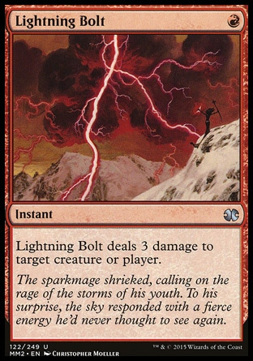
Attributes of a card
Name
Casting Cost
Every card has a unique name
Players must spent resources to play a card. This card costs one red to play
Type
Color
A card’s color is usually the same as the colors needed the play it.
Collector’s Number

Slide 5
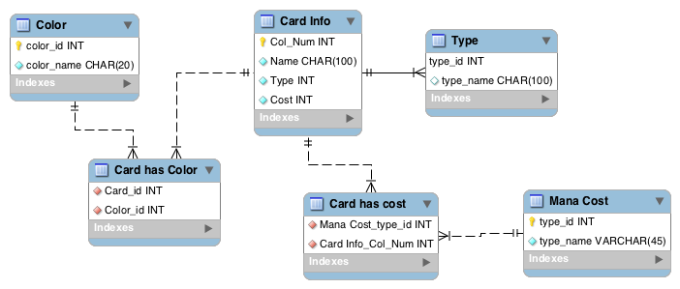
ER Diagram

Slide 6
Web Pages that use the Database
Directory of the four forms I made (http://web.simmons.edu/~scheffm/mtgLinks.html)
You can search for a card name using its color and type. (eg., red creature)
You can search for a card’s information using all or part of it’s name. (eg., “li” or “lightning bolt”)
You can search for all cards of a type (eg., instant)
You can add a land card to the database using its name and collector’s number (eg., “Port Town” 278278)

Slide 7
Special Thanks to…
Wizards of the Coast (and gatherer.wizards.com, which is their database of magic cards)
Wikipedia’s article about Magic: The Gathering
Google images
My friend who listened to me going on and on about this project and was extremely patient and helpful

